Slide 1

First Steps in Object-Oriented Programming
SoftUni Team
Technical Trainers
Software University
https://softuni.bg

Slide 2
Table of Contents
Project Architecture
Scope and Namespace
Basics of OOP
Object
Class
Instance
Creating and Using Classes
2

Slide 3
Have a Question?
sli.do
#python-advanced

Slide 4

Project Architecture
Splitting Code into Logical Parts

Slide 5
Splitting Code into Functions (1)
We use methods to split code into functional blocks
Improves code readability
Allows for easier debugging
for move in moves:
for row in range(len(room)):
for col in range(len(room[row])):
if room[row][col] == 'b':
…
for move in moves:
move_enemies()
killer_check()
move_player(move)

Slide 6

Splitting Code into Functions (2)
A single function should complete a single task
do_magic ( … )
deposit_or_withdraw ( … )
deposit_and_get_balance ( … )
parse_data_and_return_result ( … )
withdraw ( … )
deposit ( … )
get_balance ( … )
to_string ( … )

Slide 7
Problem: Rhombus of Stars
Draw on the console a rhombus of stars with a size of n
n = 3
n = 2
n = 1
*
* *
* * *
* *
*
*
* *
*
*

Slide 8
Solution: Rhombus of Stars
def print_row(size, star_count):
for row in range(size – star_count):
print(" ", end="")
for row in range(1, star_count): print("*", end=" ")
print("*")
size = int(input())
for star_count in range(1, size):
print_row(size, star_count)
for star_count in range(size, 0, -1):
print_row(size, star_count)
Reusing code

Slide 9

Scope and Namespace
Local, Global and Built-In Namespace

Slide 10
What is Namespace?
A mapping from names to objects
Examples:
Built-in names, for example the abs() function
Global names in a module
Local names on a function invocation
There is no relation between names in different namespaces
10

Slide 11
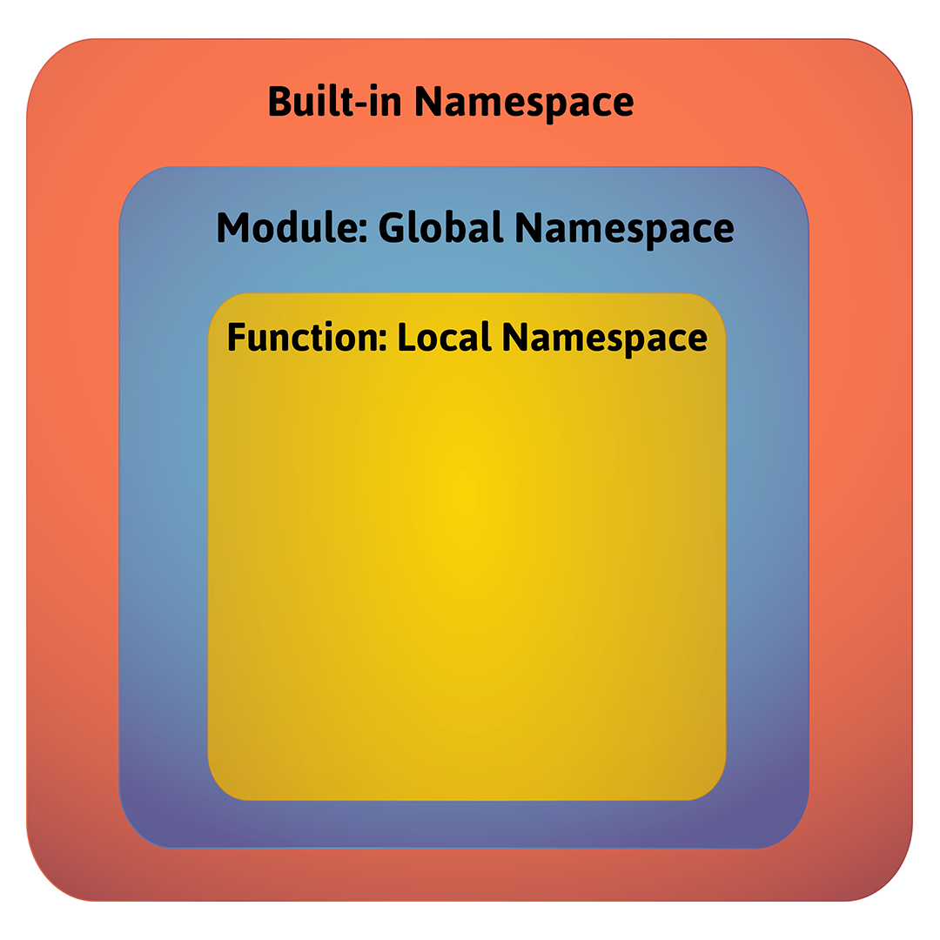
Namespaces Order

Slide 12
What is a Scope?
A region in a program where a namespace is directly accessible
In most of the cases there are at least three nested scopes:
The innermost is checked first
The scopes of any enclosing functions
The next-to-last scope (module's global names)
The outermost (built-in names)
12

Slide 13
Scopes Example
def scopes():
def local_scope():
text = "local text"
Local Scope
def nonlocal_scope():
nonlocal text
text = "nonlocal text"
Nonlocal Scope
def global_scope():
global text
text = "global text"
Global Scope
13

Slide 14
Problem: Scope Mess
Fix the provided code, so it prints the result expected
Download code from here
# current output
global
outer: local
inner: nonlocal
outer: local
global
# expected output
global
outer: local
inner: nonlocal
outer: nonlocal
global: changed!
14

Slide 15

Solution: Scope Mess
Here are the changes that need to be made
def inner():
nonlocal x
x = "nonlocal"
print("inner:", x)
def change_global():
global x
x = "global: changed!"
15

Slide 16

Basics of OOP
Building Data Functionality Together

Slide 17
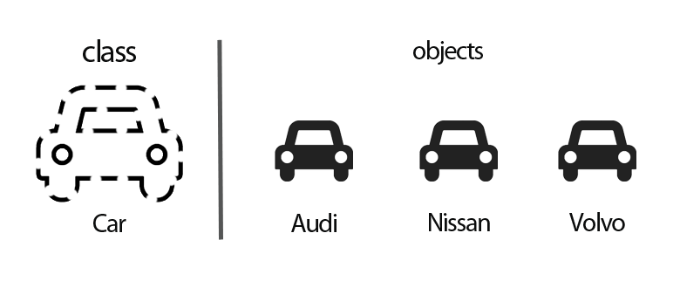
What is an Object-Oriented Programming?
It is the most popular programming paradigm
It relies on the concept of classes and objects
A class is used to create individual instance of object
17

Slide 18
Advantages of OOP
Provides a clear program structure and a clean code
Reduces complexity
Make it easy to write a reusable code
Could test each behavior of an object separately
Facilitates easy maintenance and modification of existing code
18

Slide 19
Objects in Python
Everything in Python is an object and has a type
10.5
"Python"
[1, 2, 3, 4]
{"name": "Peter", "age": 26}
We could create as many objects as we like, manipulate them, or remove them
19

Slide 20
Example
Create an object of type list
Manipulate the object by adding an element
Remove the object
Internal representation of the list is private
numbers = [1, 2, 3, 4, 8, 10]
You just need to know how to use its methods
numbers.append(5)
print(numbers) # [1, 2, 3, 4, 8, 10, 5]
del numbers
print(numbers) # Error
20

Slide 21
What is an Object?
Object is a data abstraction that captures an internal representation and an interface
The internal representation should be private
The interface defines behaviors but hides implementation
21

Slide 22

Characteristics of an Object
State
Help to distinguish an object from other objects
A phone could have a color, a size, a weight
Behavior
The tasks that an object performs
A phone could turn on, turn off

Slide 23
What is a Class?
The class is a blueprint that defines the nature of a future object
In Python a class is created by the keyword class
Class Name
class Phone:
def __init__(self, color, size):
self.color = color
self.size = size
def turn_on(self):
return 'The phone is turned on'
State
Behavior
23

Slide 24
What is an Instance?
Specific realization of an object of a certain class
The creation of an instance is called instantiation
class Phone:
def __init__(self, color, size):
self.color = color
self.size = size
phone = Phone("blue", 4.7)
Instance
24

Slide 25

Creating and Using Classes

Slide 26
Creating a Class
The keyword class defines a new type
We define the state of the object using attributes
class Person:
pass
Type Person
Special Method
class Person:
def __init__(self, name, age):
self.name = name
self.age = age
Attributes
26

Slide 27
Problem: Class Book
Create a class called Book
Upon initialization it should receive a name, author and pages (number)
Submit only the class in the judge system
Use test code to test your code
book = Book("My Book", "Me", 200)
print(book.name)
print(book.author)
print(book.pages)
My Book
Me
200
27

Slide 28

Solution: Class Book
class Book:
def __init__(self, name, author, pages):
self.name = name
self.author = author
self.pages = pages
28

Slide 29
Method
We define the behavior of the object using methods
It is like a function, that works only within a class
class Animal:
def __init__(self, name):
self.name = name
def sleep(self):
return "sleeping.."
animal = Animal("cat")
print(animal.sleep()) # sleeping..
Defining a Method
29

Slide 30
Using a Class
Using a class means creating new instances of object and executing operation on the instances
class Person():
def __init__(self, name, age):
self.name = name
self.age = age
def eat(self):
return 'eating..'
person = Person()
print(person.eat()) # eating..
Instance
30

Slide 31
Problem: Car
Create a class Car that receives name, model and engine upon initialization
It should have a method called get_info() which returns 'This is {name} {model} with engine {engine}'
Submit only the class in the judge system
car = Car("Kia", "Rio", "1.3L B3 I4")
print(car.get_info())
This is Kia Rio with engine 1.3L B3 I4
31

Slide 32
Solution: Car
class Car:
def __init__(self, name, model, engine):
self.name = name
self.model = model
self.engine = engine
def get_info(self):
return f'This is {self.name} {self.model} ' \
f'with engine {self.engine}'
32

Slide 33
Problem: Music
Create a class Music that receives title, artist and lyrics upon initialization
It should have 2 methods
print_info() - returns 'This is {title} from {artist}'
play() - returns the lyrics
Submit only the class in the judge system
Test your code with your own examples
33

Slide 34
Solution: Music
class Music:
def __init__(self, title, artist, lyrics):
self.title = title
self.artist = artist
self.lyrics = lyrics
def print_info(self):
return f'This is "{self.title}" from "{self.artist}"'
def play(self):
return self.lyrics
34

Slide 35

Summary
OOP relies on the concept of classes and objects
Object is a data abstraction that captures an internal representation and an interface
Class is a blueprint that defines a nature of a future object
Instance is a specific realization of any object

Slide 36
Questions?
Notes:
36

Slide 37












SoftUni Diamond Partners

Slide 38


Educational Partners

Slide 39

License
This course (slides, examples, demos, exercises, homework, documents, videos and other assets) is copyrighted content
Unauthorized copy, reproduction or use is illegal
© SoftUni – https://about.softuni.bg
© Software University – https://softuni.bg
Notes:
39

Slide 40
Trainings @ Software University (SoftUni)
Software University – High-Quality Education, Profession and Job for Software Developers
softuni.bg, softuni.org
Software University Foundation
softuni.foundation
Software University @ Facebook
facebook.com/SoftwareUniversity
Software University Forums
forum.softuni.bg
40
Notes:
40

